Slide 1

Track Module 2 Medical Image Analysis using Neural Networks
Ekaterina Golubeva
09.03.2023

Slide 2
Plan for today
Concepts
Recall: Neural networks
Data augmentation
Binary classification
Implementation
Malarial cell classification using CNN
Data augmentation using keras
Malarial cell classification using CNN and data augmentation
Literature overview
Problems encountered
Questions

Slide 3
Recall : Neural Networks and Deep learning

Slide 4
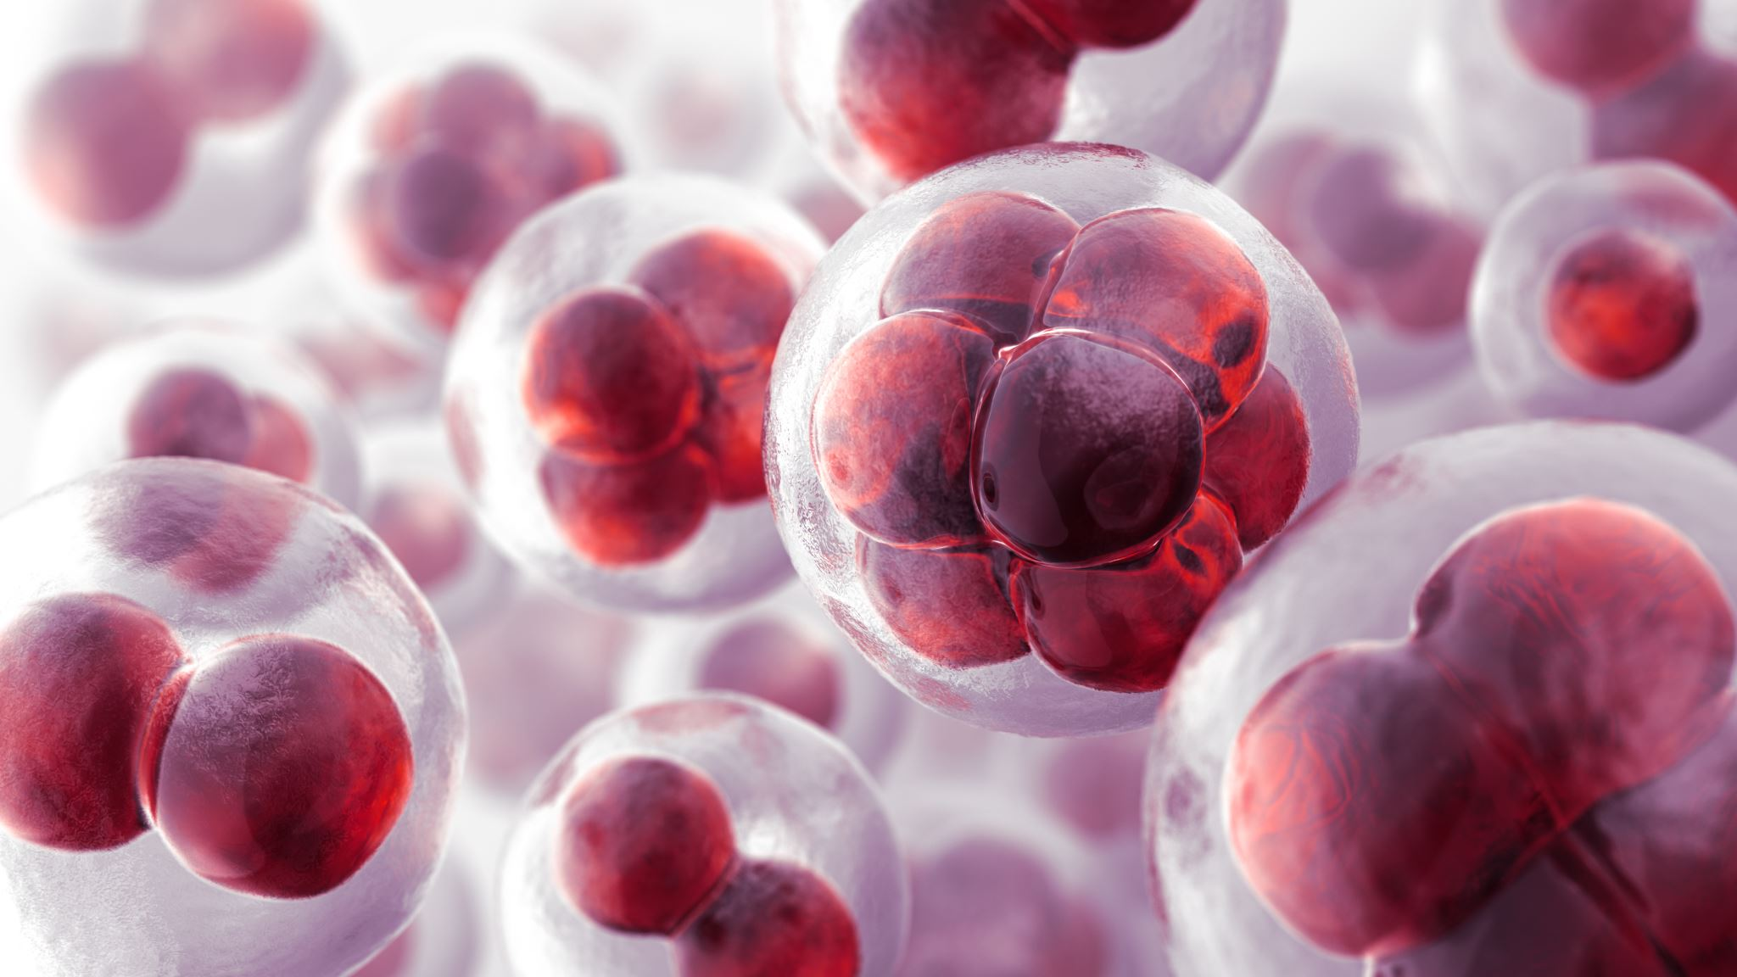
Implementation : Malarial cell detection using CNN

Slide 5

Data augmentation
Image data augmentation is the process of generating new transformed versions of images from the given image dataset to increase its diversity.
These augmented images resemble those already present in the original dataset but contain further information for better generalization of the machine learning algorithm.
tf.keras.preprocessing.image.ImageDataGenerator

Slide 6

Data Augmentation using keras

Slide 7
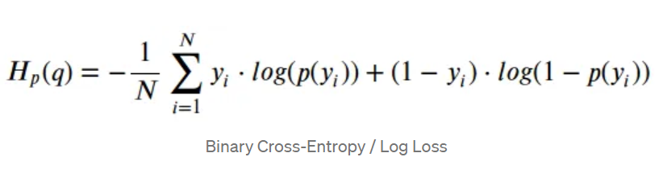
Binary classification loss function : Binary cross entropy

Slide 8
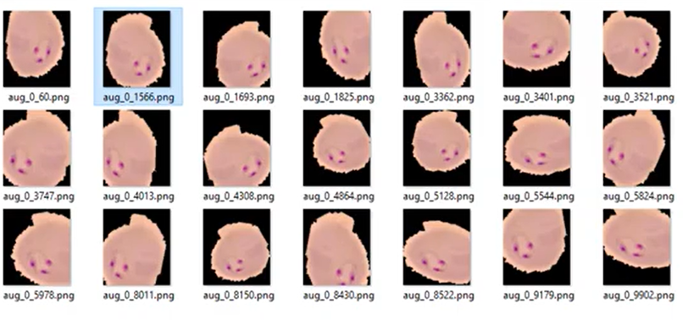
Malarial cell classification using CNN and data augmentation

Slide 9

Workflow summary
Create an Image Data Generator
Define the CNN model
Apply data augmentation using datagen.flow for single image and .flow_from_directory for a folder
Fit the model on the augmented data using model.fit
Save the model and check the accuracy using validation set

Slide 10
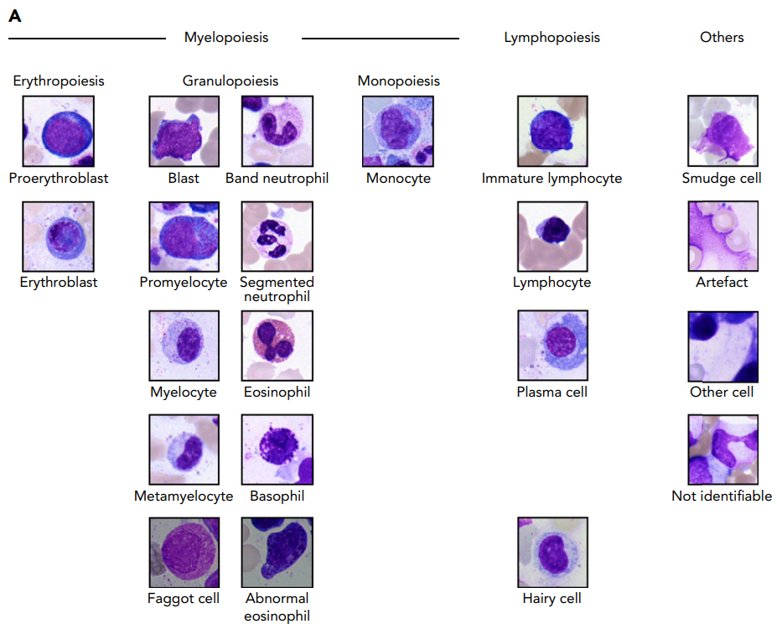
Highly accurate differentiation of bone marrow cell morphologies using deep neural networks on a large image data set
A data set of >170 000 microscopic images allows training neural networks for identification of BM cells with high accuracy.
Neural networks outperform a featurebased approach to BM cell classification and can be analyzed with explainability and feature embedding methods.
ResNext -50 architecture – image classification network

Slide 11
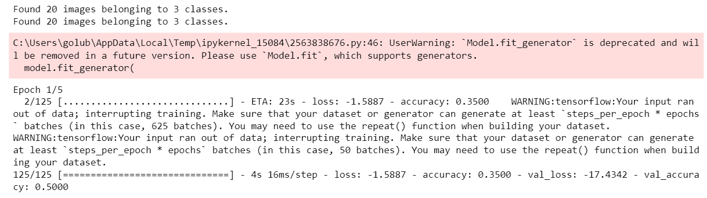
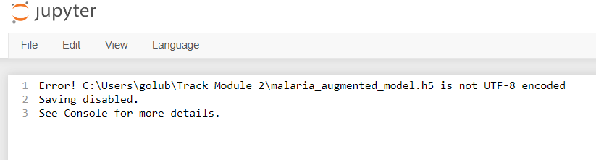
Problems encountered
Incompatibility with package versions.
Number of epochs, batches and input data size, classes
Model saving
Lack in biological terminology

Slide 12
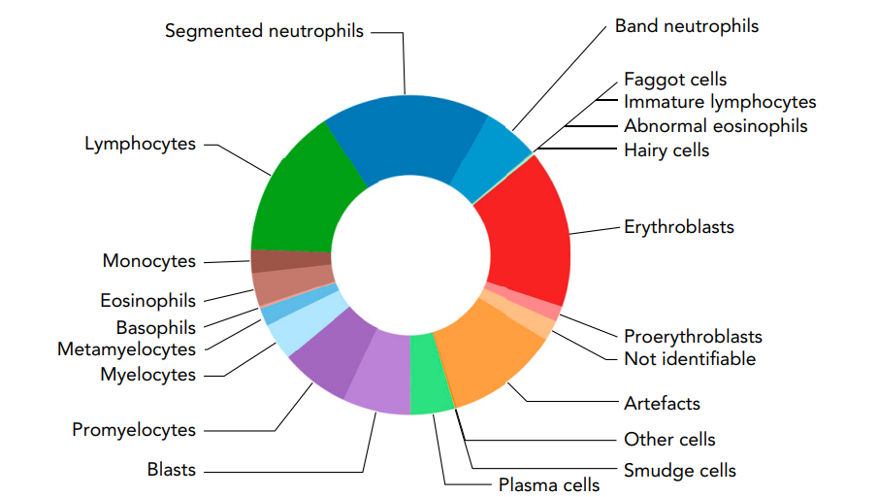
Next steps
Overview of Bone Marrow cell morphologies ?
Read Georgiana’s Master thesis
Learn what checkpoints are in Deep learning

Slide 13
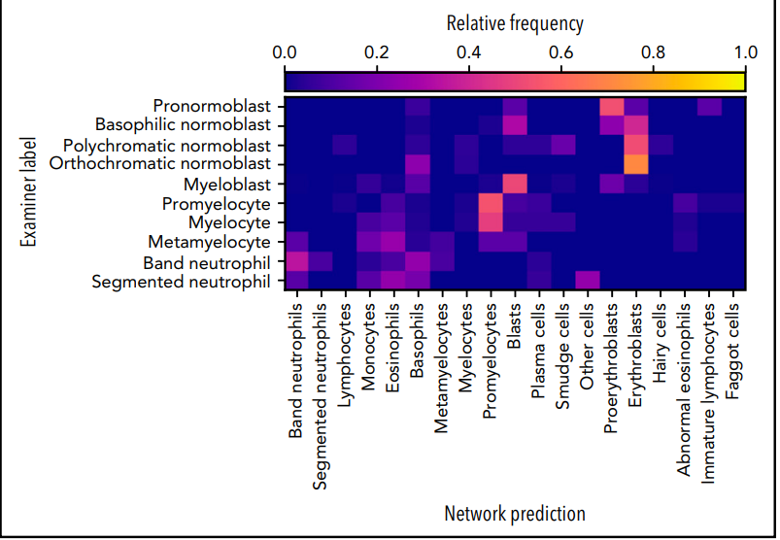
Questions
How to read this confusion matrix ?
Is a model supposed to be displayed when saved and in which format ?
“Evaluating deep learning training strategies for the classification of bone marrow cell images” paper questions
Is there a smart way to make sure my packages versions/names of modules are up to date ?

Slide 14
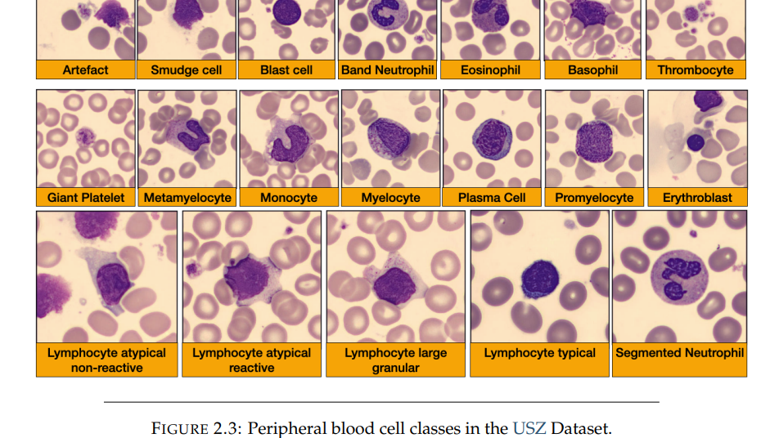
Evaluation of Deep Neural Networks for Haematology Image Classification

